Slide 1


Session II
REALSOFT-ME.COM

Slide 2
At the end of this session we will be able to:
Construct responsive website layout’s
Develop an understanding of different use cases for CSS positioning and display properties and structure the layout of a web page.
-
-
Develop interactive websites using JavaScript
Use JavaScript to control a webpage and learn what the Document Object Model (DOM) is.
Effectively create the structure of a website using semantic HTML, and style websites with CSS and responsive layouts.
The goal of this training is to equip learners with the unique skills they need to build and develop great websites and applications.

Slide 3
Sessions Overview
Session I: HTML
How to structure content in your webpage
Session I: CSS
How to style the content in your webpage
Session II: JS
Interactive content
Add events to your webpage
Session III: NodeJS
How to setup a server
deal with files
Database CRUD operations in Node JS
Session IV: Angular
What is Angular JS

Slide 4
Objectives (Section II: CSS)
What is CSS, and how you can use it to style your website.
How to use CSS selectors and properties.
Learn about how to use inline, internal and external CSS.
Class vs. Ids and how to target each.
CSS display and how to implement layout.
How to use CSS static, relative and absolute positioning systems.
Font styling using CSS and web safe fonts.
How to use CSS float and clear.
How combine CSS selectors and understand selector priority

Slide 5
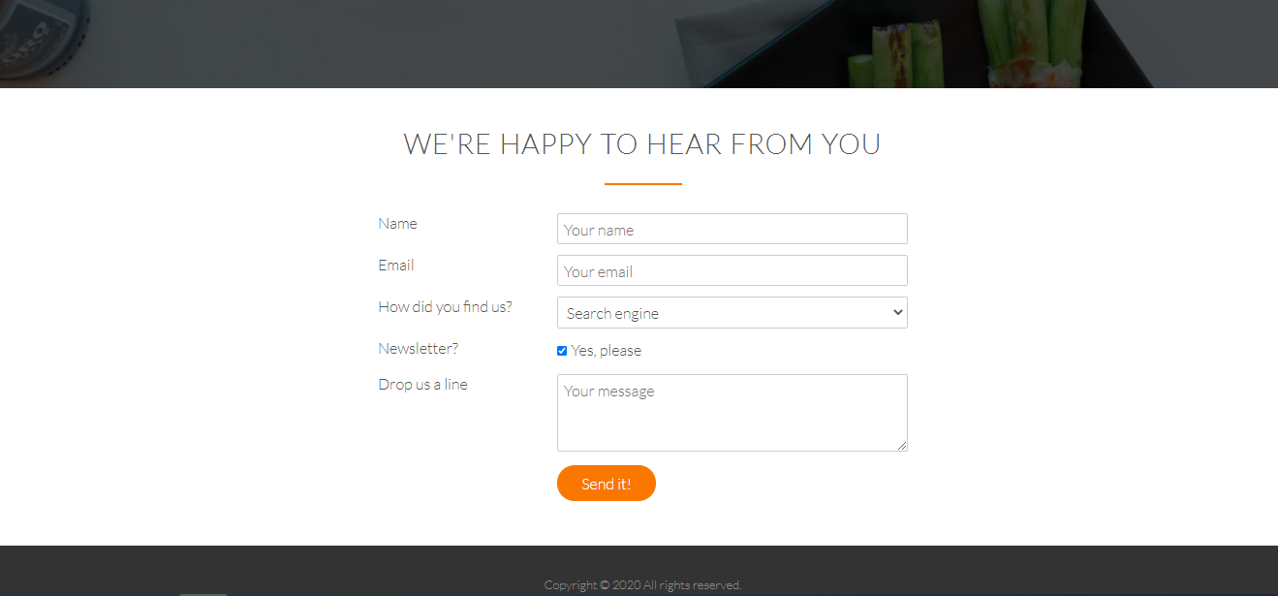

Session II
HTML
Headers
Hyperlinks
Images
Div
Span
Forms
CSS
Fonts
Colors
Backgrounds
Positioning

Slide 6

RESOURCES
https://www.codecademy.com/learn/learn-css/modules/learn-css-box-model/cheatsheet
W3schools (Documentation)
https://devdocs.io/
https://developer.mozilla.org/en-US/

Slide 7
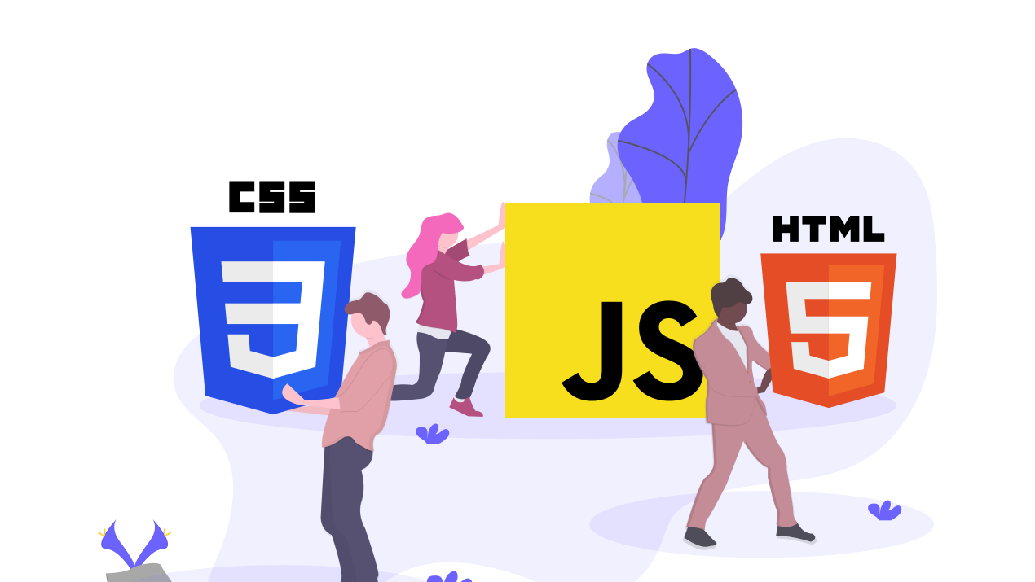
HTML -> PAGE STRUCTURE
CSS -> STYLE
JS -> Behavior
https://codepen.io/giana/pen/GJMBEv
Notes:
HTML – nouns
CSS - adjectives
JS – verbs
-------------------------
EXAMPLES
“THE RED CAR IS MOVING” RED -> CSS / CAR -> HTML / MOVING -> JS
“THE FLUFFY CAT IS SLEEPING” …
https://codepen.io/giana/pen/GJMBEv
Try to remove the CSS & JS

Slide 8

Styling your website

Slide 9
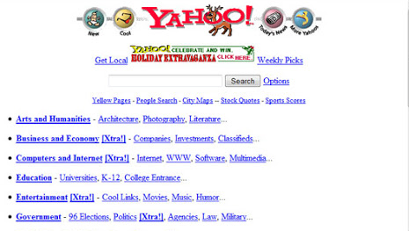
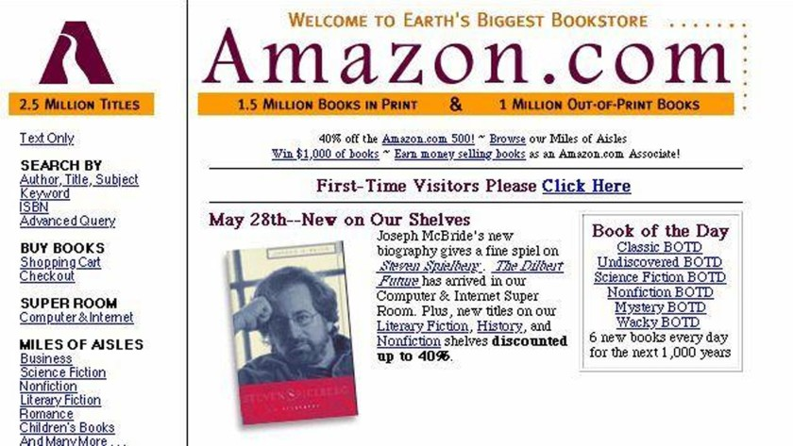
Looking Bad? Look at some popular website back then … without CSS
https://archive.org/web/
Notes:
Prof Thomas Website:
https://www.cs.dartmouth.edu/~thc/
https://www-cs-faculty.stanford.edu/~knuth/

Slide 10
Tips
Emmet Shortcuts
https://docs.emmet.io/cheat-sheet/
IDE Shortcuts:
Show Suggestions: ctrl + Space
Multiple selections: hold alt and click
Toggle SideBar: ctrl+B
Duplicate UP: alt+shoft+up arrow
Duplicate Down: alt+shift+down arrow
Comment Selection: ctrl + /
Format document: alt + shift + f
Notes:
div>ul>li>h2 (CHILD NESTING)
ul>li*3 (MULTIPLE ELEMENTS)
ul+div+a (ADJACENT ELEMENTS)

Slide 11
CSS (Cascading Style Sheets)
Changing the webpage style back then was only through (HTML TAG’S & ATTRIBUTES)
While websites were growing, and improvements were added it became a long and expensive process to handle the style and content.
Changing the layout was hard, fonts and color information were added to every single element in the page, aligning elements was not flexible at all…
To solve this problem, the World Wide Web Consortium (W3C) created CSS, to separate content from the style
With an external stylesheet file, you can change the look of an entire website by changing just one file!
Notes:
REMARK:
HTML -> STRUCTURE
CSS -> STYLE
JS -> Behavior

Slide 12

CSS
CSS is a language for describing how documents are presented visually - how they are arranged and styled.

Slide 13
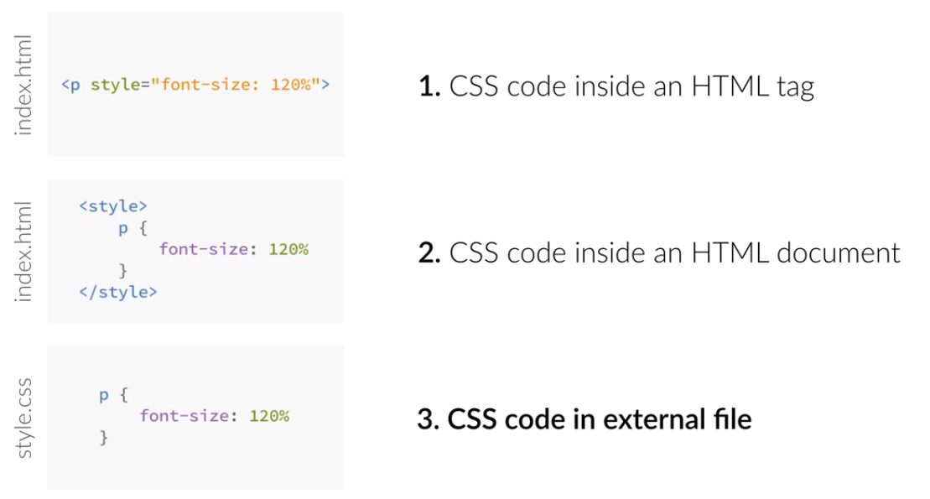
Three Ways to Insert CSS
Notes:
CSS can be added to HTML documents in 3 ways:
Inline - by using the style attribute inside HTML elements
Internal - by using a <style> element in the <head> section
External - by using a <link> element to link to an external CSS file
With an external stylesheet file, you can change the look of an entire website by changing just one file!
<head>
<link rel='stylesheet' type='text/css' href='style.css'>
</head>

Slide 14
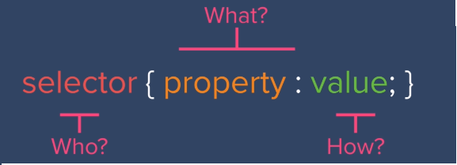
CSS Selectors

Slide 15
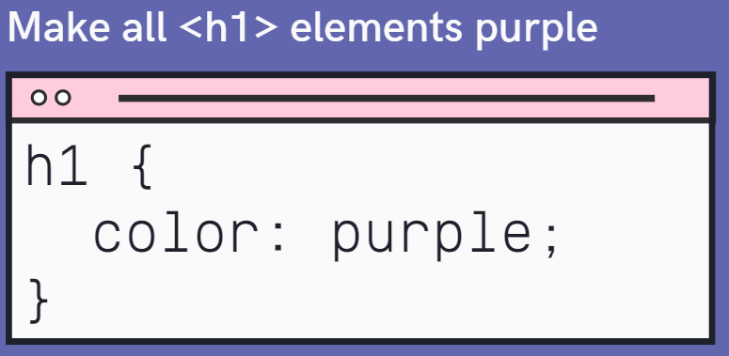

Slide 16
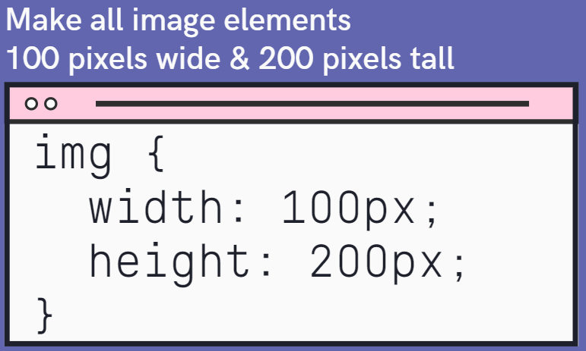
Notes:
Group All SIMILIAR STYLES TOGETHER (h1,h2 -> color, font-family)
NESTED ELEMENTS INHIRIT THE STYLE OF PARENT ELEMENTS
----------------------------------------------------------------------------------
body{
font-family: Arial;
font-size: 18px;
}
h1,h2{
color: green;
}
h1{
font-size: 40px;
}
h2{
font-size: 30px;
}
p{
text-align: justify;
}

Slide 17
Selectors
Element (Type) Selector (selects HTML elements based on the element name)
ID Selector (uses the id attribute of an HTML element to select a specific element)
To select one unique element
To select an id, write a hash (#) character, followed by the id of the element.
Class Selector (selects HTML elements with a specific class attribute)
Multiple elements can use the same class
Elements can also refer to more than one class.
To select the class, write a period (.) character, followed by the class name.
https://developer.mozilla.org/en-US/docs/Web/CSS/CSS_Selectors
Notes:
You can also specify that only specific HTML elements should be affected by a class.
(e.g.) p.center {text-align: center;}
<p> elements with class="center" will be center-aligned:

Slide 18
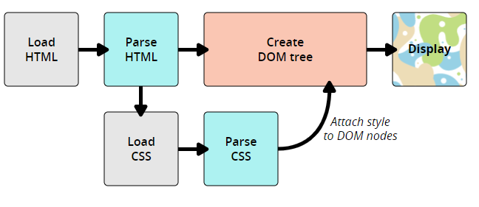
How does CSS work?
https://developer.mozilla.org/en-US/docs/Learn/CSS/First_steps/How_CSS_works#How_does_CSS_actually_work
Notes:
Skip

Slide 19
CSS Combinators
A combinator is something that explains the relationship between the selectors.
Selector | Syntax | Example | Example description
Descendant (space) | element element | div p | Selects all <p> elements inside <div> elements
Child (>) | element>element | div > p | Selects all <p> elements where the parent is a <div> element
adjacent sibling (+) | element+element | div + p | Selects all <p> elements that are placed immediately after <div> elements
general sibling (~) | element1~element2 | p ~ ul | Selects every <ul> element that are preceded by a <p> element
Notes:
Remark: do not confuse the descendant selector (space) with the grouping selector (separate each selector with a comma)
Just think of what the words "child" and "descendant" mean in English:
My daughter is both my child and my descendant
My granddaughter is not my child, but she is my descendant.
Group All SIMILIAR STYLES TOGETHER (h1,h2 -> color, font-family)
NESTED ELEMENTS INHIRIT THE STYLE OF PARENT ELEMENTS
----------------------------------------------------------------------------------
body{ font-family: Arial; font-size: 18px;}
h1,h2{color: green;}
h1{font-size: 40px;}
h2{font-size: 30px;}
p{text-align: justify;}

Slide 20

CSS Attribute Selectors
Style HTML Elements With Specific Attributes
https://www.w3schools.com/css/css_attribute_selectors.asp
Notes:
TIP: EMMET SHORTCUT: btn.btnClass{Click Me}
<button class="btn1">Click Me</button>
btn#btn-1{Click}
<button id="btn-1">Click</button>

Slide 21
CSS PSUEDO CLASS
Different styles for different states
a:hover
class1:hover
:checked -> For radio buttons and checkboxes
.post:nth-of-type(3) -> Third element
.post:nth-of-type(2n) -> Every other element
.post:nth-of-type(odd)
p::selection -> When highlighting elements
Notes:
select elements based on a special state
==========================
.main-div:hover{
color: blue;
background-color:black;
}

Slide 22
CSS RESOURCES
CSS REFRENCE:
https://developer.mozilla.org/en-US/docs/Web/CSS/Reference
CSS CHEATSHEET
https://web.stanford.edu/group/csp/cs21/csscheatsheet.pdf
CSS COLORS:
https://developer.mozilla.org/en-US/docs/Web/CSS/color_value
CSS BORDERS:
https://developer.mozilla.org/en-US/docs/Web/CSS/border-style
https://farbvelo.elastiq.ch
http://colinkeany.com/blend
Notes:
https://cssbuttoncreator.com
http://colinkeany.com/blend
https://bennettfeely.com/clippy/
https://github.com/bradtraversy/design-resources-for-developers

Slide 23

CSS Colors

Slide 24
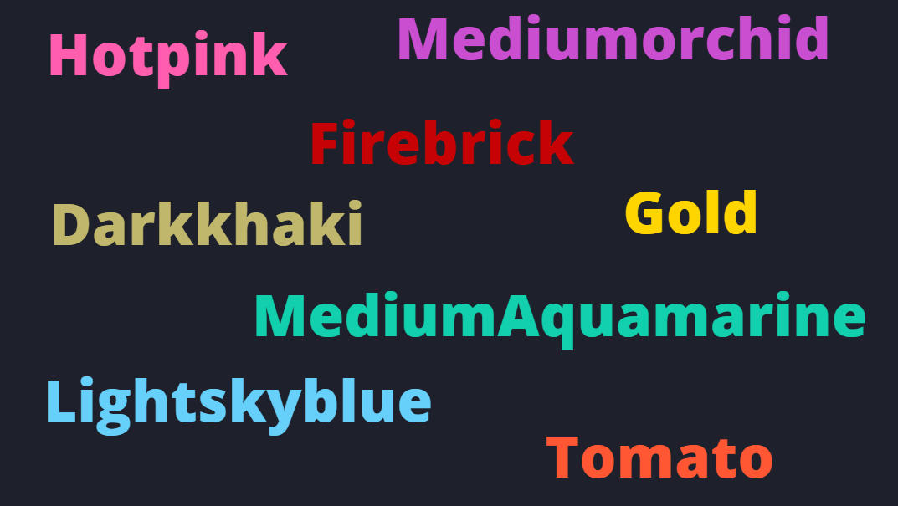
Named Colors
https://www.w3schools.com/colors/colors_names.asp

Slide 25


Slide 26
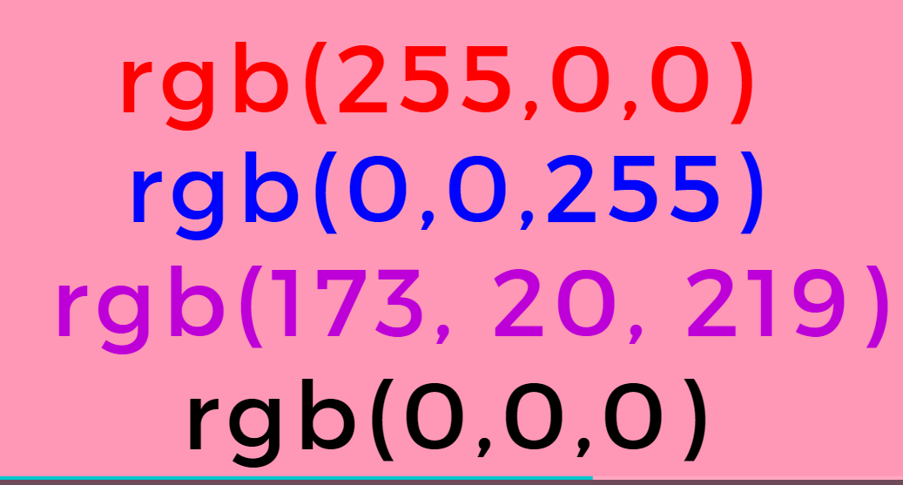

Slide 27
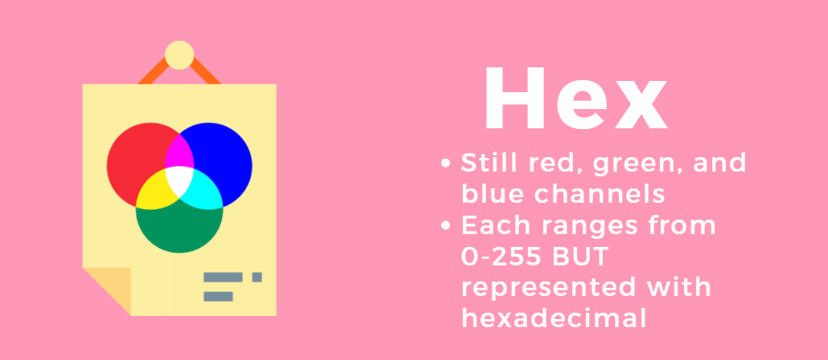

Slide 28
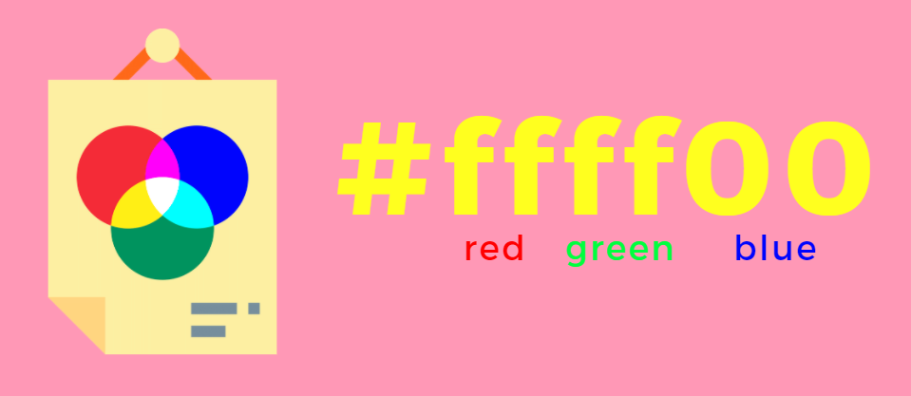

Slide 29
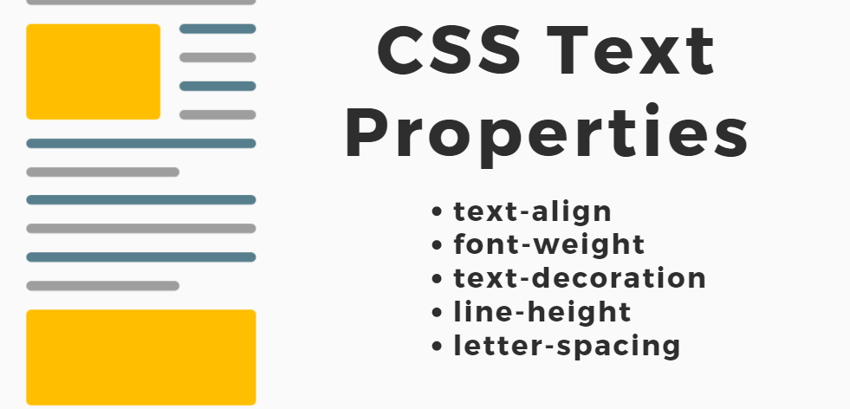
https://developer.mozilla.org/en-US/docs/Web/CSS/text-decoration
Notes:
h1 {text-align: center;}
h1{text-decoration: underline;}
h1{text-decoration: underline dotted pink;}
h1{letter-spacing: 5px; word-spacing: 30px;}
p{line-height: 30px;}

Slide 30

CSS BOX MODEL

Slide 31

All HTML elements are rendered as a box.
The box has four parts (or layers):
Margin: The outermost part is the margin between this HTML element to other HTML elements.
Border: The border sits inside the margin and surrounds the padding and content of the HTML element.
Padding: The padding sits inside the border and surrounds the content of the HTML element.
Content: The content of an HTML element is whatever is displayed inside the HTML element. This is typically a combination of text, images and other HTML elements.

Slide 32
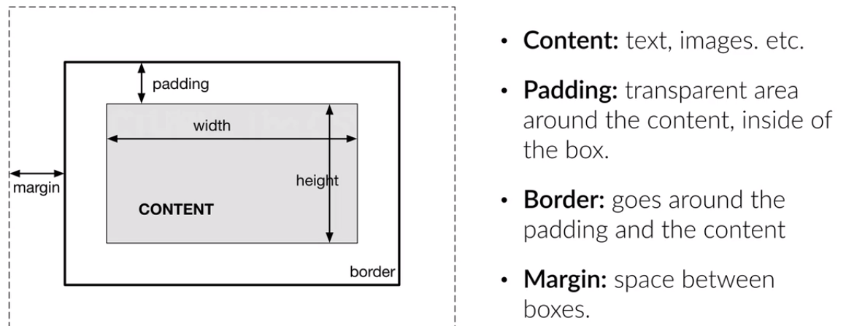
CSS BOX MODEL
Notes:
All HMTL elements are treated as a box, then we can style that box (width, margin, padding …) to change the layout of the element

Slide 33

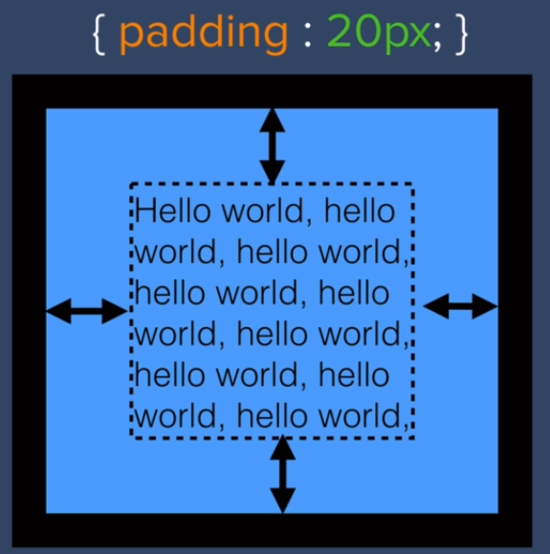

Slide 34
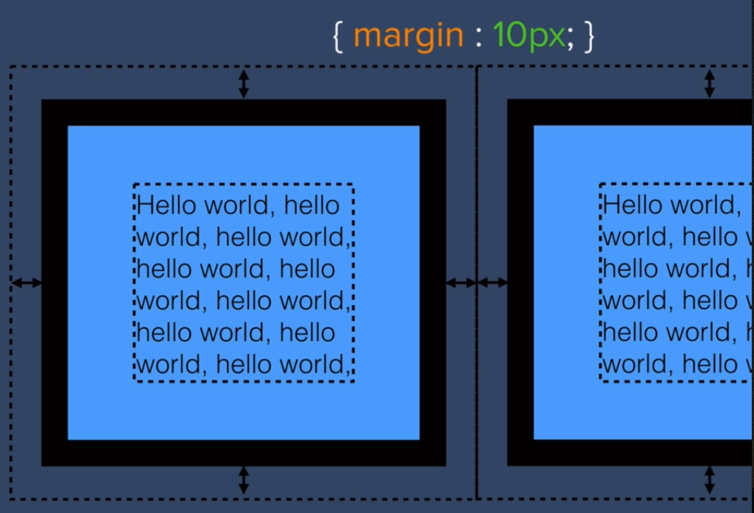

Slide 35
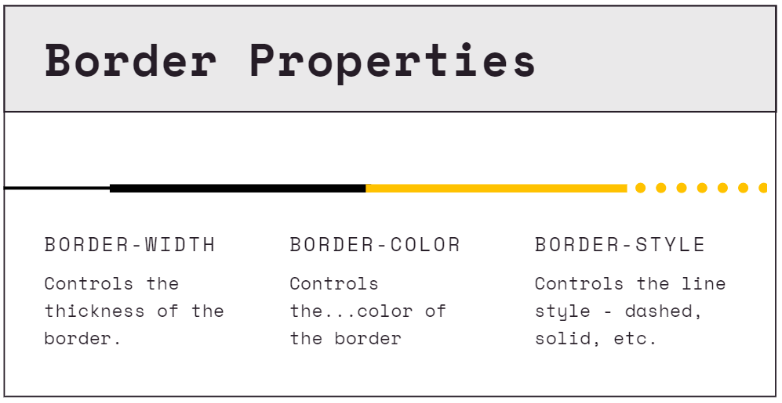
Notes:
.border {
border-style: dotted;
border-color: crimson;
border-width: 5px;
}
// Also Border Radius -> border-radius: 25px;

Slide 36
The size of the box itself is calculated like this:
Width | width + padding-left + padding-right + border-left + border-right
Height | height + padding-top + padding-bottom + border-top + border-bottom
This means: When you set the width/height of an element, the element often appears bigger than you have set (because the element's border and padding are added to the element's specified width/height).
Notes:
https://www.w3schools.com/css/css3_box-sizing.asp
The CSS box-sizing property allows us to include the padding and border in an element's total width and height.

Slide 37

Display
Every HTML element has a default display value.
Notes:
QUICK DEMO:
USE <span>
The first 3 characters are blue
<p class='a'> <span class='b'>PRO</span>GRAMMER </p>
<div> Used to format block content with CSS
<span> Used to format inline content with CSS

Slide 38
The display property
Specifies how an element is displayed.
(Display: inline, block, inline-block, none)
Notes:
MAKE DIVS & SPANS (THEN CHANGE THE DISPLAY)

Slide 39
Display
The default display value for most elements is block or inline.
BLOCK ELEMENTS: <p> <h> <div> <form>
Takes 100% of the parents width
Starts on a new line
INLINE ELEMENTS: <img> <em> <a> <span>
Takes space as much as they need to fit content
Does not start on a new line
Notes:
QUICK DEMO: FOR A
<p> a single word cannot be styled

Slide 40

The display property:
Inline elements fit in alongside other elements
Any height & width properties will be ignored.
Margin & padding push elements away horizontally but not vertically.
Block level elements take up a whole "block" of space.
Elements start on a new line, and they take up the whole width
The width could be changed
Notes:
MAKE DIVS (or h1) & SPANS (THEN CHANGE THE DISPLAY)
Quick Task: Display a list of links as a horizontal menu: li { display: inline;} ->>>
-> ADD HOVER -> REMOVE PADDING > Add height to ul (to avoid pushing down elements below)

Slide 41
The display property
The element itself is formatted as an inline element, but you can apply height and width values
The element disappears (the element’s space is removed)
Inline-Block
None
Notes:
INLINE-BLOCK : (also padding, and margin)
None is different from visibility: hidden (hidden does not remove the element, instead it can’t be seen) // The element is not visible, but still affects layout

Slide 42
Often used as a container for other HTML elements. When used together with CSS, <div> could be used to style blocks of content
An inline container used to mark up a part of a text, or a part of a document. When used together with CSS, <span> could be used to style parts of the text
The <div> element
The <span> element
Notes:
QUICK DEMO:
USE <span>
The first 3 characters are blue
<p class='a'> <span class='b'>PRO</span>GRAMMER </p>
<div> Used to format block content with CSS
<span> Used to format inline content with CSS

Slide 43

Position
how an element is positioned in a document.

Slide 44

Position
The position CSS property sets how an element is positioned in a document.
The top, right, bottom, and left properties determine the final location of positioned elements
Types of positioning:
Static
Relative
Absolute
Fixed
sticky

Slide 45

Position
Static
the static value is the default behavior for HTML elements
Most often you will not need to set position to static. Instead you would just not set the position CSS property at all

Slide 46
Position
Relative
element will be adjusted away from its normal position.
Other content will not be adjusted to fit into any gap left by the element
In other words, adds a margin in relative to were it should have been
To specify where to position the HTML element you have four extra CSS properties: top, left, bottom, right

Slide 47
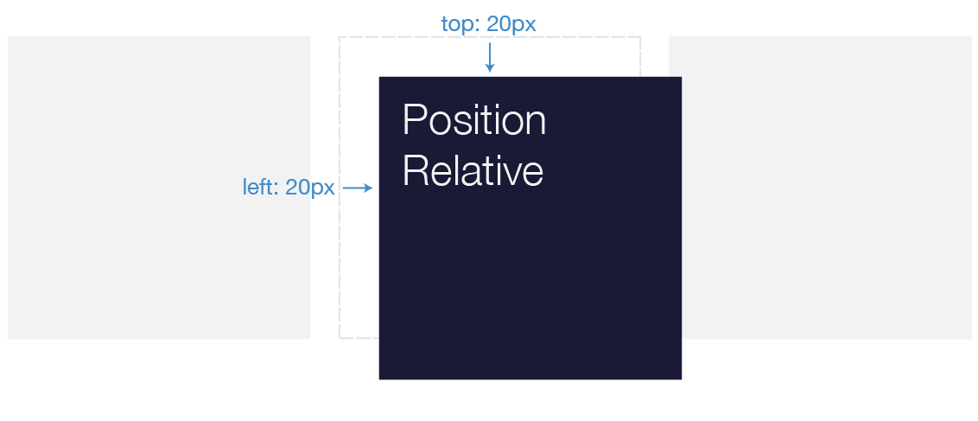
position: relative;
when you use an offset to visually move an element with {position: relative}, the space that it takes up in the document doesn’t move.
Notes:
(so it won’t affect anything around it.)
It's like our box has a free spirit and can go wherever it wants, but always in relation to where it was originally.

Slide 48
Position
Absolute
Adds a margin relative to the parent
Other elements are affected (changes the flow of the HTML)

Slide 49
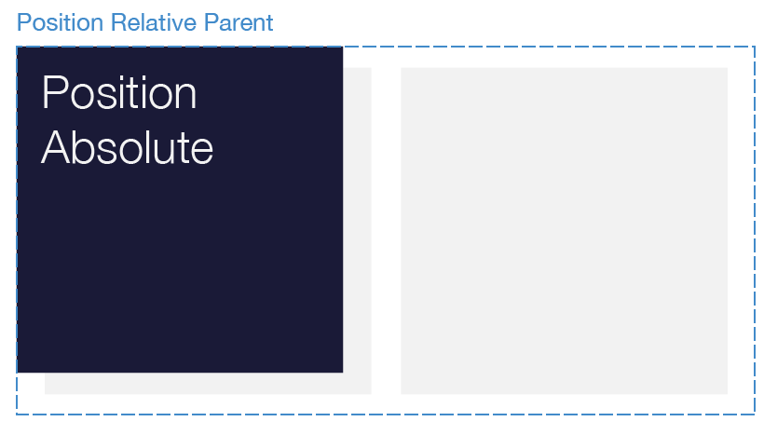
position: absolute;
The element is taken out of normal flow and leaves no space behind.
The element is positioned relative to its nearest parent with a relative-type positioning.
Notes:
The space will collapse
specifies that you want to take your element out of normal flow, leaving no space behind, and offset its position relative to the nearest parent which also has a relative-type positioning.
Remember that these values will be relative to the next parent element with relative (or absolute) positioning. If there is no such parent, it will default all the way back up to the <html> element itself meaning it will be placed relative to the page itself.

Slide 50
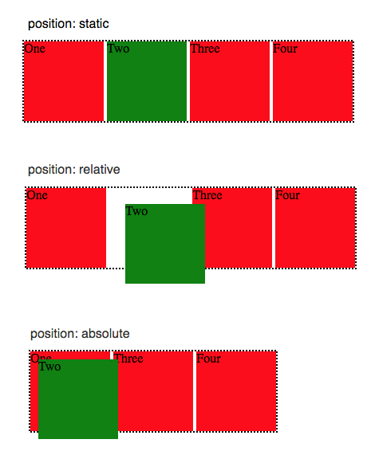
{position: relative}
places an element relative to its current position without changing the layout around it,
{position: absolute}
places an element relative to its parent’s position and changing the layout around it.
Notes:
https://developer.mozilla.org/en-US/docs/Web/CSS/position

Slide 51
position: fixed;
HTML element the property is applied to, be displayed at a fixed position inside the browser window (viewport).
Even if the user scrolls the HTML page vertically or horizontally, or resize the browswer window, the element remains fixed at the same position inside the browser window.

Slide 52
Float & Clear

Slide 53
Float
The CSS float property can make HTML elements float to the left or right inside their parent element.
Content inside the same parent element will move up and wrap around the floating element

Slide 54
Float
The float property is used for positioning and formatting content
e.g. let an image float left to the text in a container.
The float property can have one of the following values:
Left - The element floats to the left of its container
right - The element floats to the right of its container
none - The element does not float (will be displayed just where it occurs in the text).

Slide 55
Clear

Slide 56
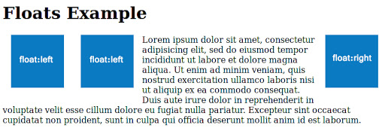

Slide 57
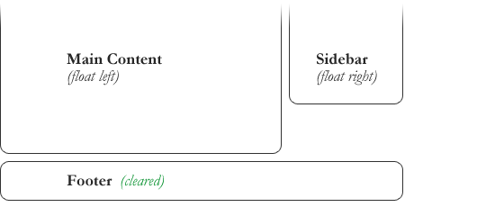

Slide 58
CSS: Order of precedence (Specificity)

Slide 59


CSS Order of precedence (Specificity)
Which CSS property values are the most relevant to an element and, therefore, will be applied
Notes:
https://www.smashingmagazine.com/2007/07/css-specificity-things-you-should-know/

Slide 60
CSS: Order of precedence (Specificity)
inline CSS ( HTML style attribute ) overrides CSS rules in style tag and CSS file
a more specific selector takes precedence over a less specific one
rules that appear later in the code override earlier rules if both have the same specificity.
A CSS rule with !important always takes precedence.
https://www.smashingmagazine.com/2007/07/css-specificity-things-you-should-know/
Notes:
https://www.smashingmagazine.com/2007/07/css-specificity-things-you-should-know/

Slide 61
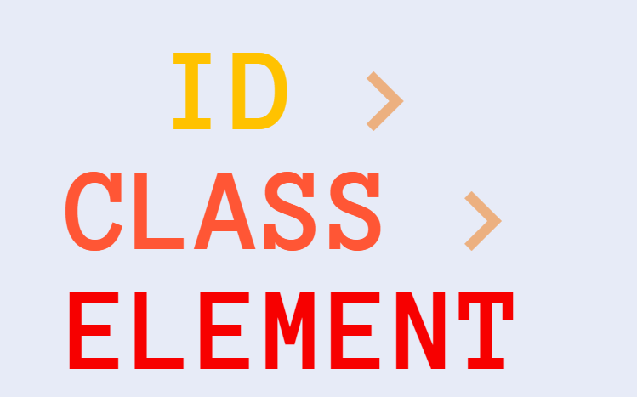
Notes:
https://specificity.keegan.st/

Slide 62
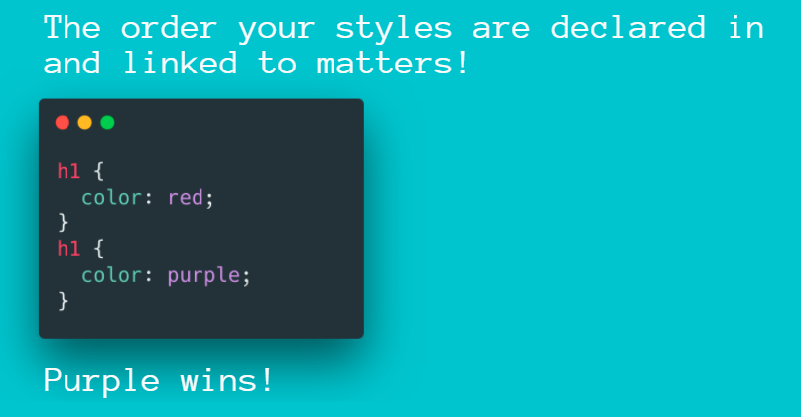

Slide 63
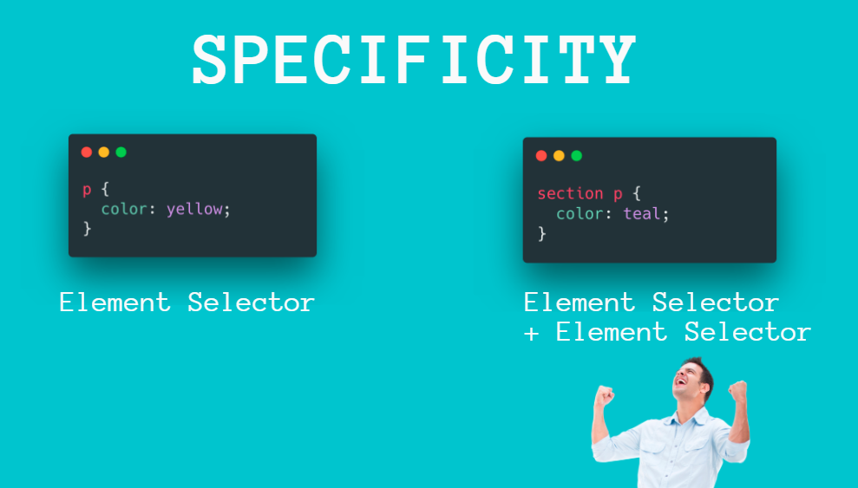
Notes:
https://specificity.keegan.st/

Slide 64
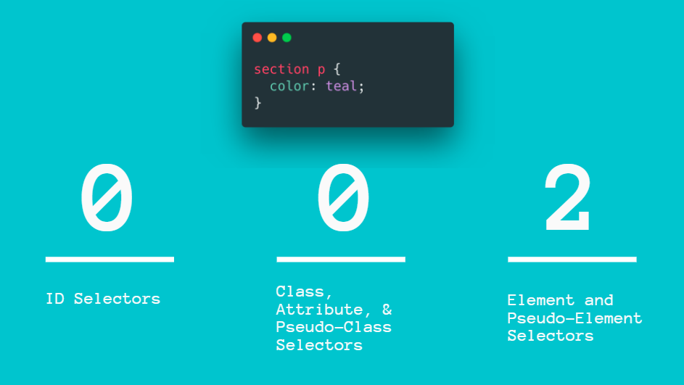
Notes:
https://specificity.keegan.st/

Slide 65
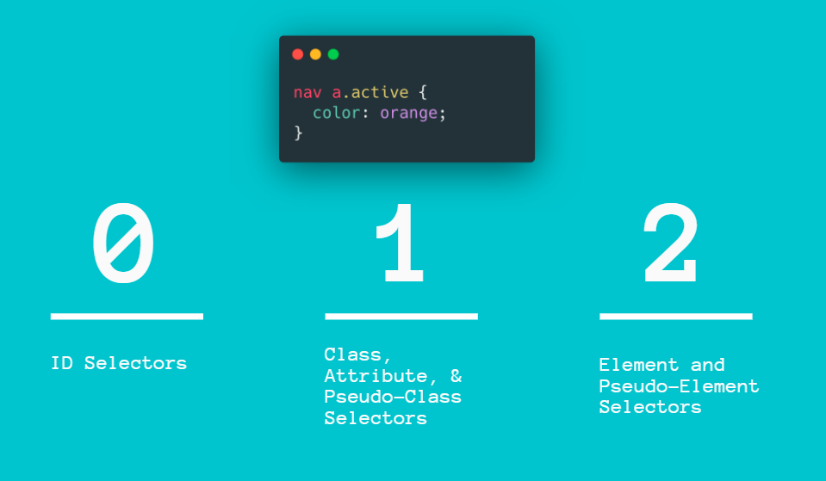
Notes:
https://specificity.keegan.st/

Slide 66
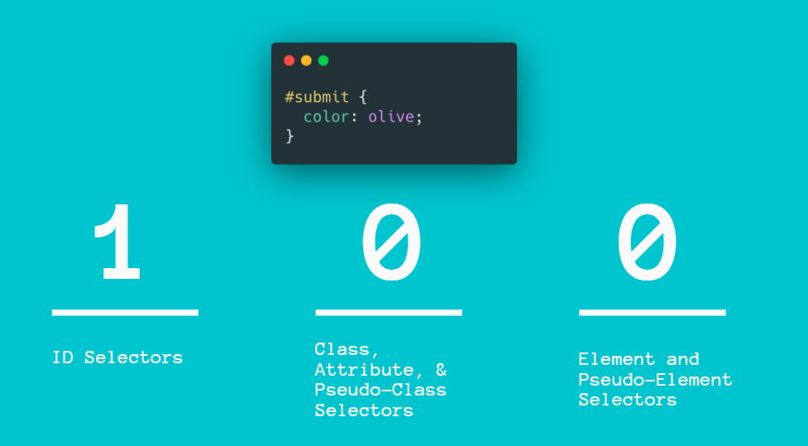
Notes:
https://specificity.keegan.st/

Slide 67
Notes
When multiple declarations have equal specificity, the last declaration found in the CSS is applied to the element
Universal selector (*), combinators (+, >, ~, ' ', ||) have no effect on specificity.

Slide 68
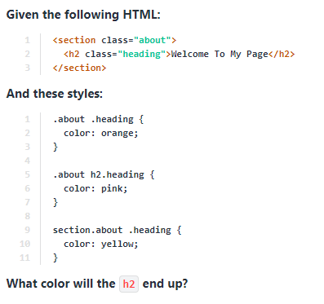
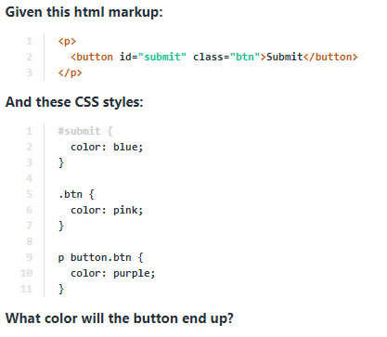
Notes:
Blue -> ID (The id selector is super-specific and it beats out the other selectors in this case.)
Yello -> This selector is tied in specificity with the one above it, but it "wins" because it comes last in the file!

Slide 69
Flex
https://css-tricks.com/snippets/css/a-guide-to-flexbox/
https://css-tricks.com/almanac/properties/f/flex-wrap/

Slide 70

CSS Debugging

Slide 71
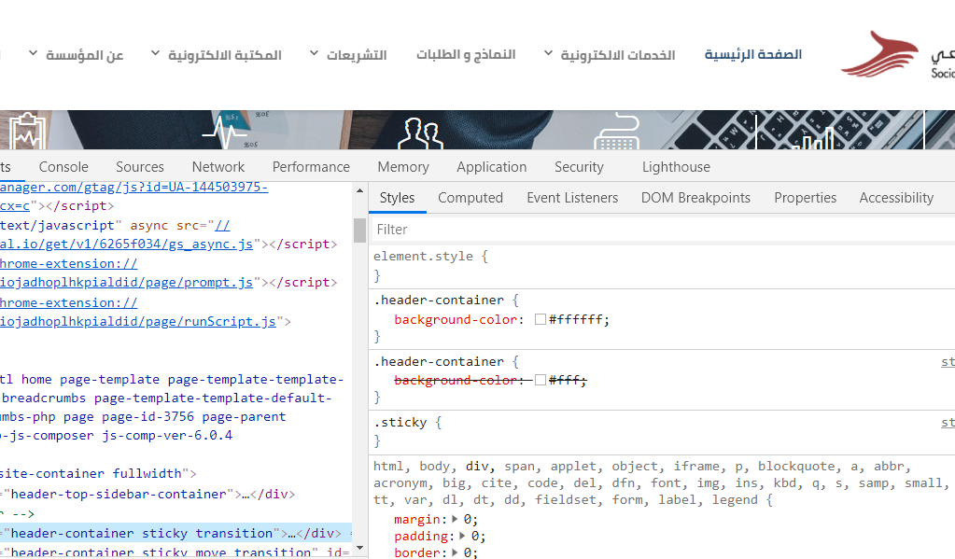
CSS Debugging
Chrome Developer Tools
http://jigsaw.w3.org/css-validator
Notes:
Any crossed out property means that it has applied and overwritten by another selector or the same selector but written later in the CSS file
Live-edit styles if necessary
Force a pseudo state

Slide 72
Side Note
CSS can be quite frustrating for a beginner. Have patience when learning how to select individual elements and how-to layout a whole page.
I suggest you keep practicing it bit-by-bit. Whenever you make a new app, spend some time trying a different part of CSS to learn it. Whenever you stumble across a site you think looks cool, try to re-create it.

Slide 73
Utilities
Vector icons https://www.flaticon.com/
Vectors https://fontawesome.com/
Google Fonts https://fonts.google.com/
Image Editing https://crop-circle.imageonline.co/
Color Pallets https://colorhunt.co/
FavIcon Generator https://www.favicon.cc/
CSS Button https://cssbuttoncreator.com/
https://bennettfeely.com/clippy/
http://colinkeany.com/blend
https://github.com/bradtraversy/design-resources-for-developers
neumorphism.io
https://sweetalert2.github.io/
Notes:
Normalize.css
A CSS file that provides better cross-browser consistency in the default styling of HTML elements
https://necolas.github.io/normalize.css/
Responsive
Flexible way to create a responsive web site
http://www.responsivegridsystem.com/
0to255
lighten and darken colors
www.0to255.com

Slide 74
PROJECT TIME

Slide 75
End Of
Session II
REALSOFT-ME.COM

